Slide 1


ROSHAN PAUDEL
16/11/2015

Slide 2

Outline
Executive Summary
Introduction
Methodology
Results
Conclusion
Appendix

Slide 3
Executive Summary
Data collected via SpaceX API and Web Scraping.
Data wrangling performed to clean and preprocess launch data.
EDA conducted using visualizations and SQL.
Interactive Folium map and Plotly Dash dashboard developed.
Classification models built to predict Falcon 9 landing success.

Slide 4
Introduction
Project background and context
Space X advertises Falcon 9 rocket launches on its website with a cost of 62 million dollars; other providers cost upward of 165 million dollars each, much of the savings is because Space X can reuse the first stage. This goal of the project is to create a machine learning pipeline to predict if the first stage will land successfully.
• Problems you want to find answers
What factors determine if the rocket will land successfully?
The interaction amongst various features that determine the success rate of a successful landing.
What operating conditions needs to be in place to ensure a successful landing program.

Slide 5

Section 1

Slide 6
Methodology
Executive Summary
Data collection methodology:
Perform data wranglingSpaceX REST API (Launch, booster, and landing data)
Web scraping from Wikipedia for payload and launch site details
Perform data wrangling
One-hot encoding was applied to categorical features
Perform exploratory data analysis (EDA) using visualization and SQL
Perform interactive visual analytics using Folium and Plotly Dash
Perform predictive analysis using classification models
How to build, tune, evaluate classification models

Slide 7
Data Collection
The data was collected using various methods
Data collection was done using get request to the SpaceX API.
Next, we decoded the response content as a Json using .json() function call and turn it into a pandas dataframe using .json_normalize().
We then cleaned the data, checked for missing values and fill in missing values where necessary.
In addition, we performed web scraping from Wikipedia for Falcon 9 launch records with BeautifulSoup.
The objective was to extract the launch records as HTML table, parse the table and convert it to a pandas dataframe for future analysis.

Slide 8
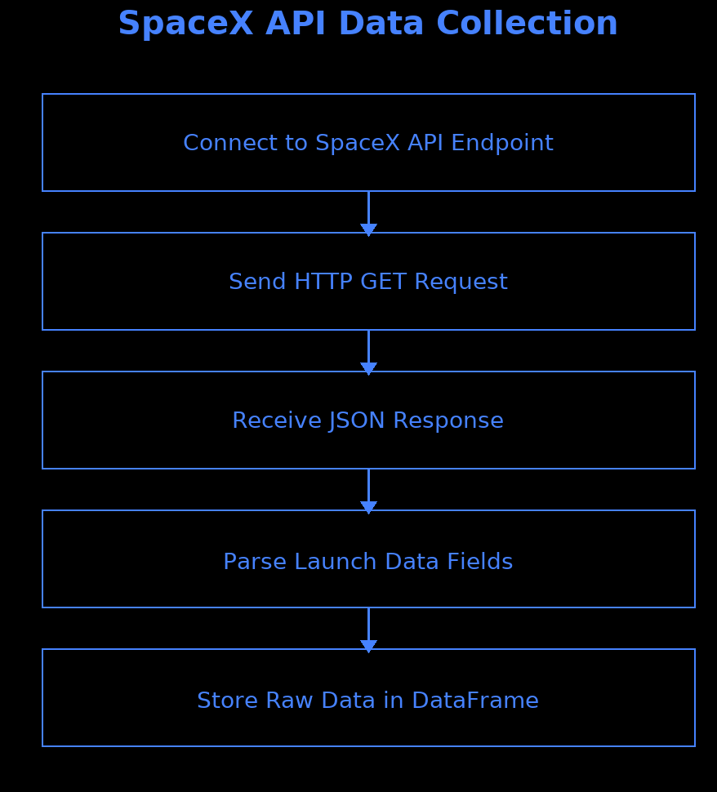
Data Collection – SpaceX API
We used the get request to the SpaceX API to collect data, clean the requested data and did some basic data wrangling and formatting.
The link to the notebook is Data Collection python file github link.

Slide 9
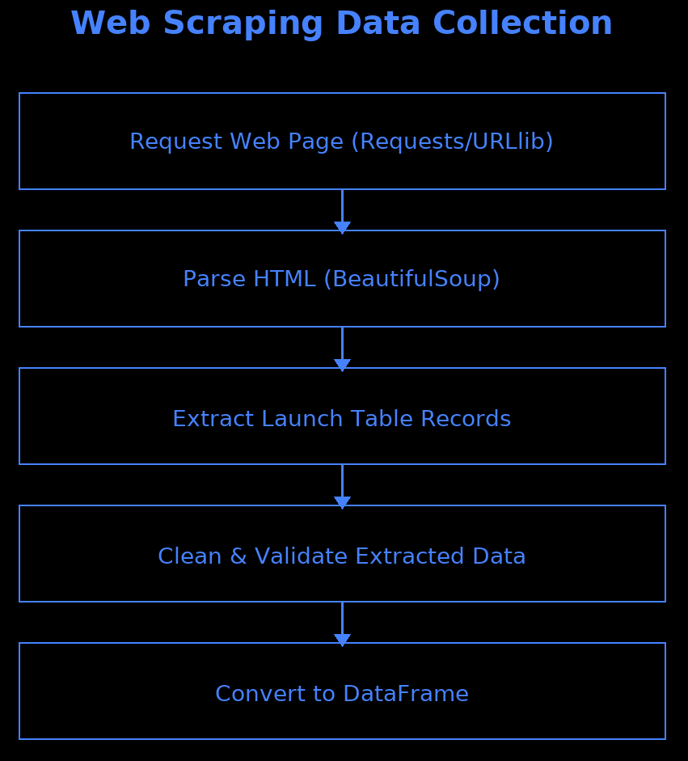
Data Collection - Scraping
We applied web scrapping to webscrap Falcon 9 launch records with BeautifulSoup
We parsed the table and converted it into a pandas dataframe.
The link to the notebook is Data Scraping

Slide 10
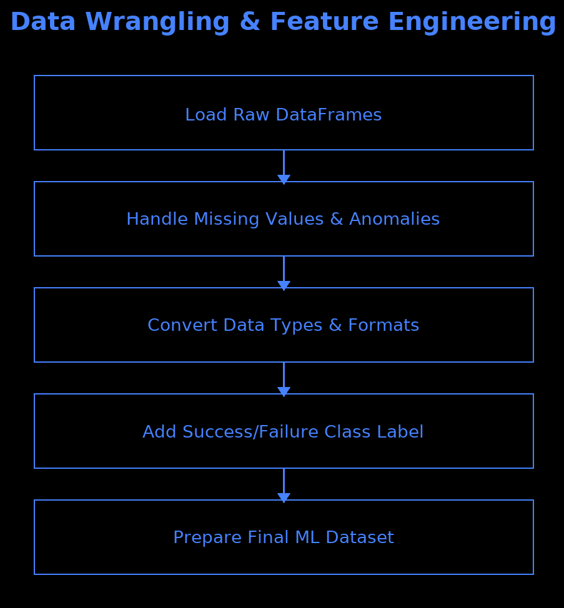
Data Wrangling
We performed exploratory data analysis and determined the training labels.
We calculated the number of launches at each site, and the number and occurrence of each orbits.
We created landing outcome label from outcome column and exported the results to csv.
The link to the notebook is Data Weangling

Slide 11
EDA with Data Visualization
Data Visualization is most necessary as a part of Exploratory Data Analysis. This helps in analyzing the data in an easier way using graphs and charts.
Scatter plots were created between many attributes to obtain their relationship.
Bar Charts, Line Charts and Cat plots were also created to analyze the data.
The link to the notebook is EDA with Visualization

Slide 12
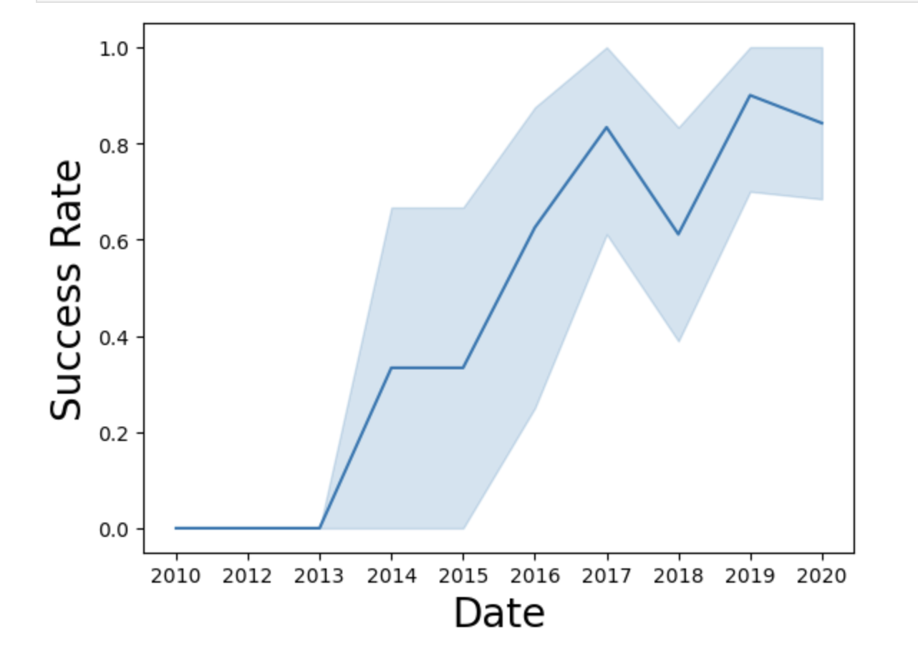
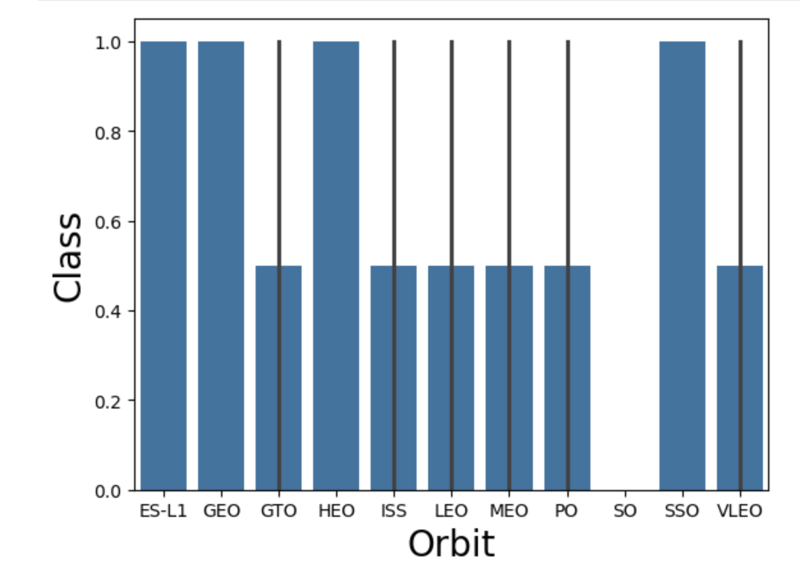
EDA with Data Visualization

Slide 13
EDA with SQL
We will be adding the data to a database where we can query the reuired results using SQL.
We have displayed the names of unique launch sites, total payload mass carried by boosters launched by NASA (CRS) and many more,
We can SQL and extract the data for analysis using Pattern Matching, Buil-in Mathematical Functions and many more
The link to the notebook is EDA with SQL

Slide 14
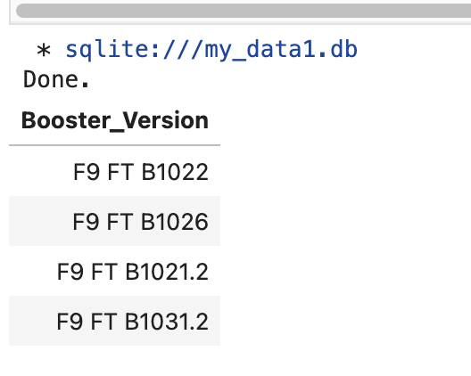
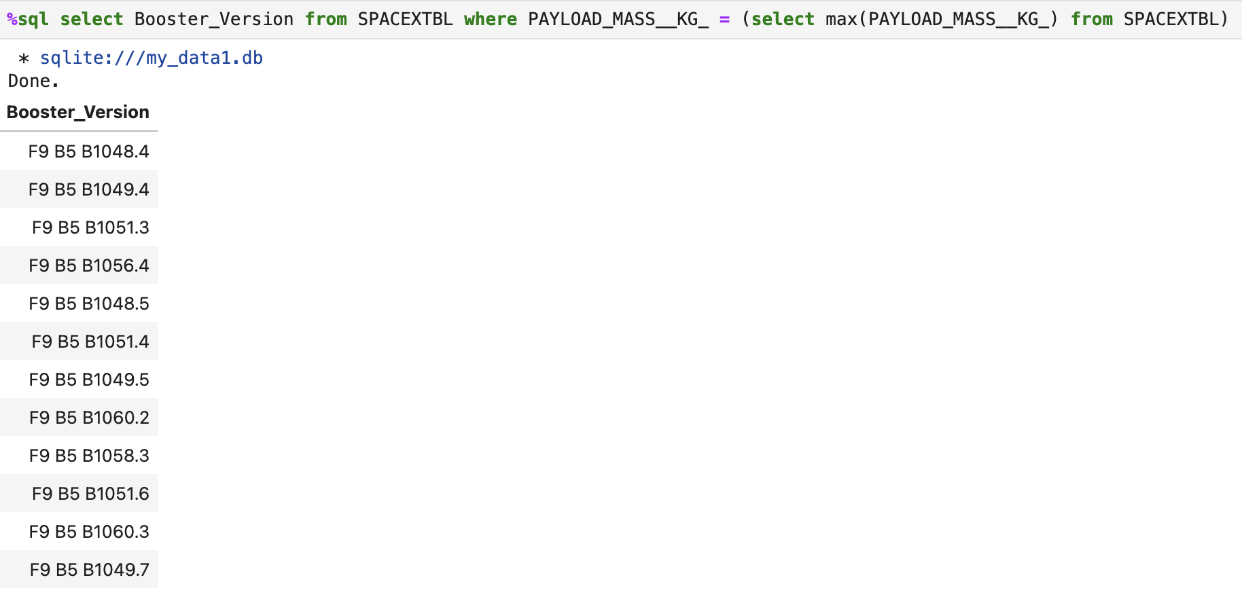
EDA with SQL EXAMPLES

Slide 15
Build an Interactive Map with Folium
We marked all launch sites, and added map objects such as markers, circles, lines to mark the success or failure of launches for each site on the folium map.
We assigned the feature launch outcomes (failure or success) to class 0 and 1.i.e., 0 for failure, and 1 for success.
Using the color-labeled marker clusters, we identified which launch sites have relatively high success rate.
We calculated the distances between a launch site to its proximities.
The link to the notebook is Visual analytics of folium
We answered some question for instance:
Are launch sites near railways, highways and coastlines.
Do launch sites keep certain distance away from cities.

Slide 16
Build a Dashboard with Plotly Dash
We have created a real-time visual dashboard using Plotly which provides better view of Graphs and Charts.
The plots were added to the dashboard because it provides real-time experience to the users with a great view of data.
Added a dropdown to the dashboard to select launch sites and find the EDA of that particular launch site.
The link to the notebook is Plotly Dash

Slide 17
Predictive Analysis (Classification)
We loaded the data using numpy and pandas, transformed the data, split our data into training and testing.
We built different machine learning models and tune different hyperparameters using GridSearchCV.
We used accuracy as the metric for our model, improved the model using feature engineering and algorithm tuning.
We found the best performing classification model.
The link to the notebook is Modelling

Slide 18
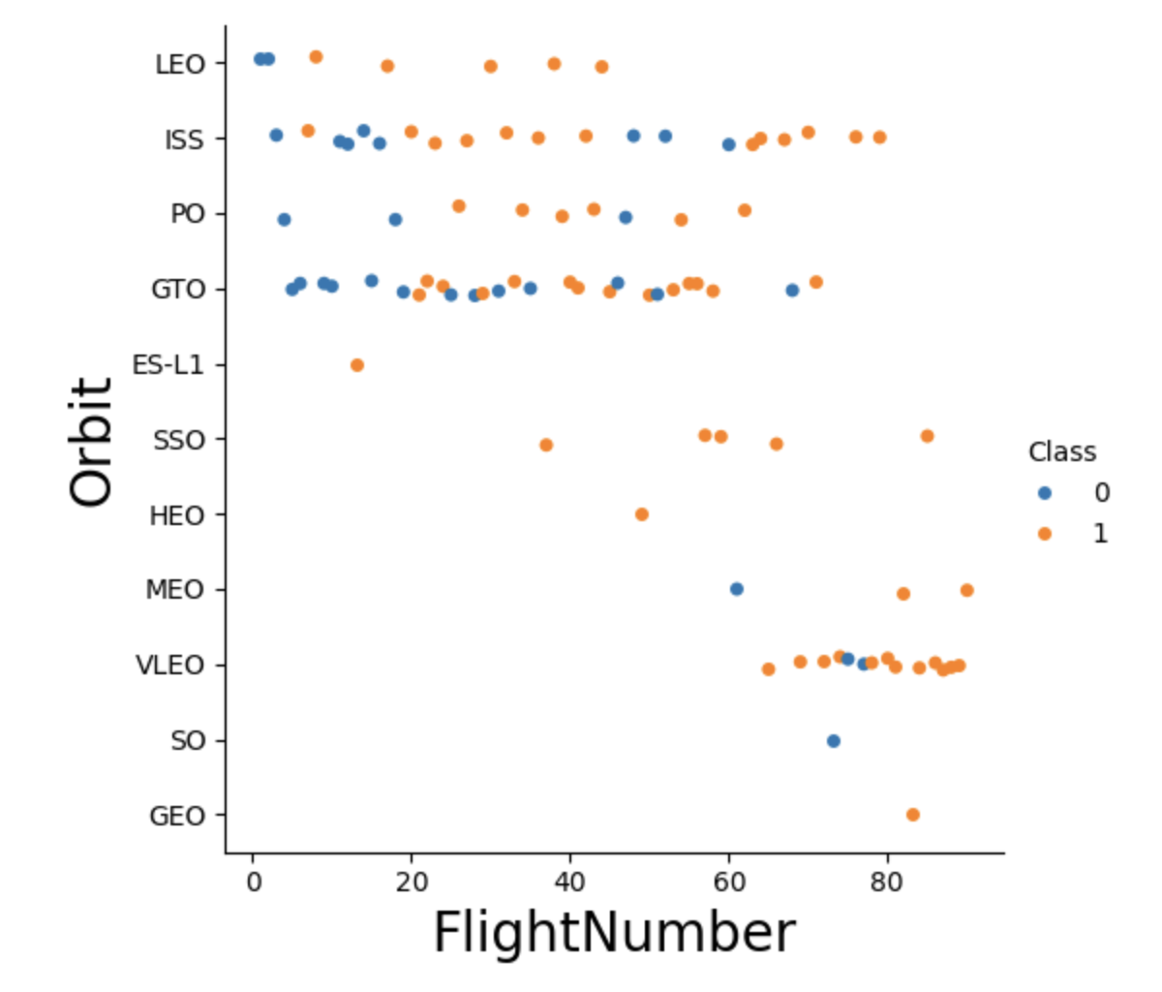
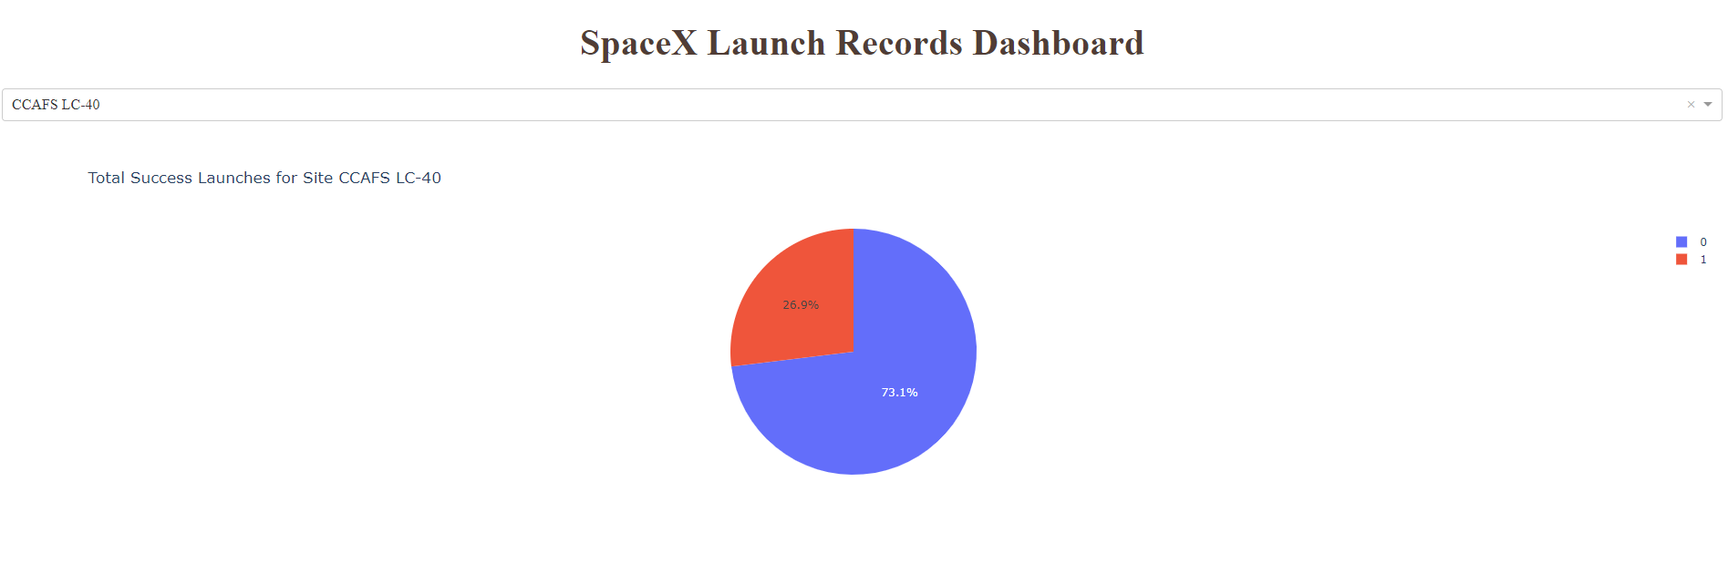
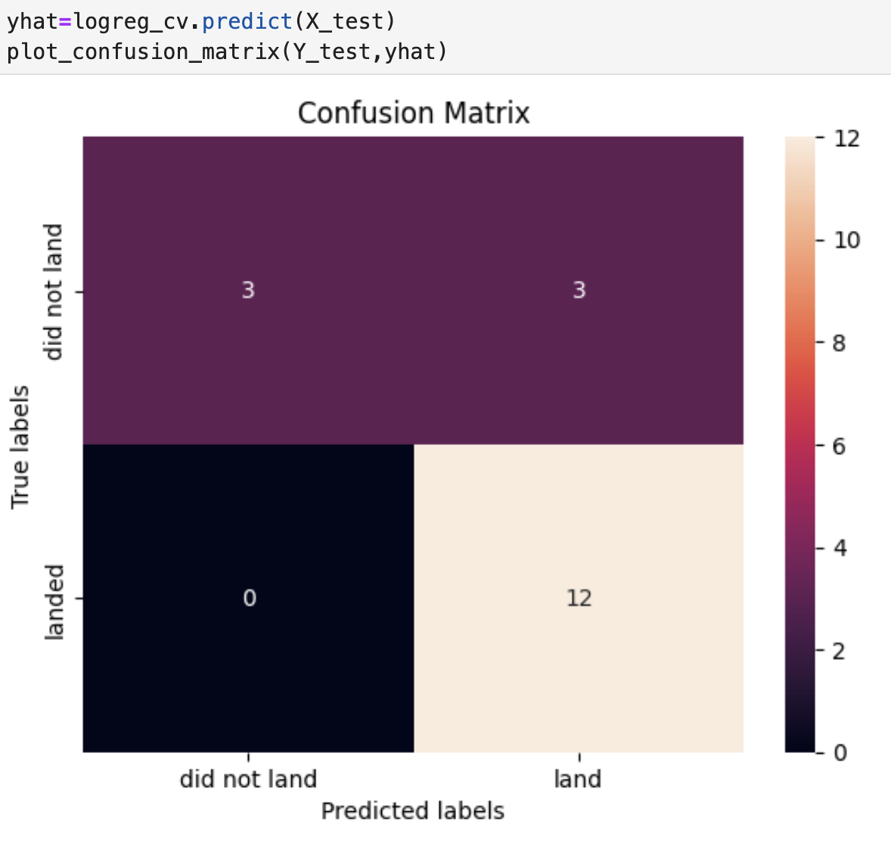
Results
Exploratory data analysis results :
Interactive analytics samples :
Predictive analysis results :

Slide 19

Section 2

Slide 20
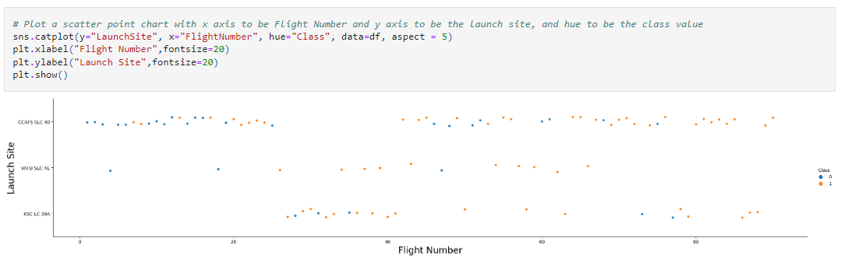
Flight Number vs. Launch Site
From the plot, we found that the larger the flight amount at a launch site, the greater the success rate at a launch site.

Slide 21
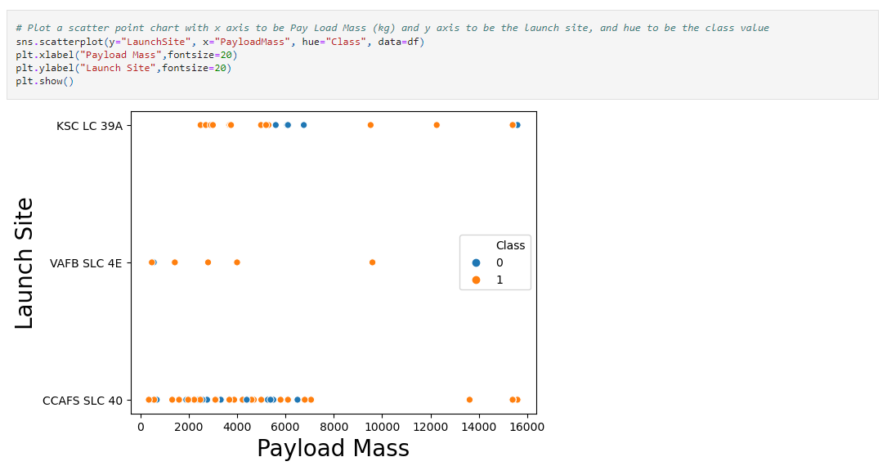
Payload vs. Launch Site
We can find that heavier Payload Mass rockets are launched in KSC LC 39A and CCAFS SLC 40 Launch Sites.

Slide 22
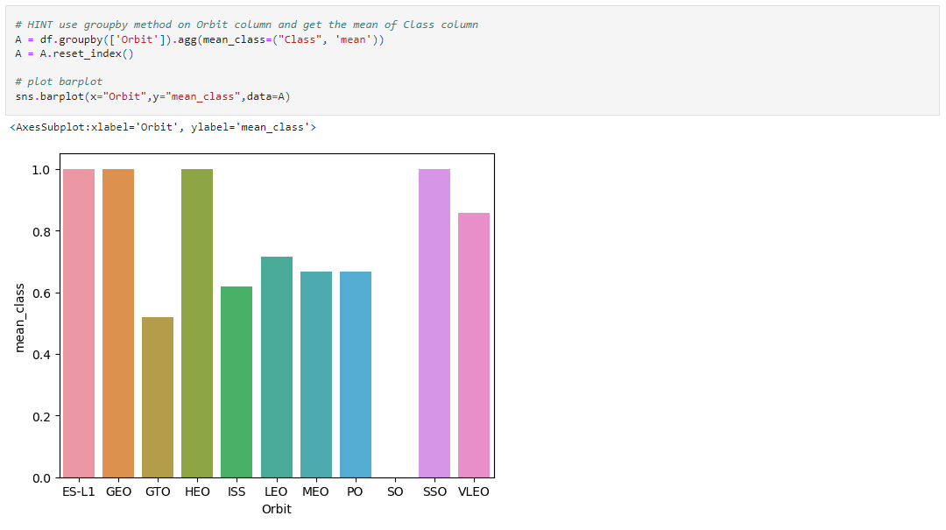
Success Rate vs. Orbit Type
From the plot, we can see that ES-L1, GEO, HEO, SSO, VLEO had the most success rate

Slide 23
Flight Number vs. Orbit Type
The plot below shows the Flight Number vs. Orbit type. We observe that in the LEO orbit, success is related to the number of flights whereas in the GTO orbit, there is no relationship between flight number and the orbit.

Slide 24
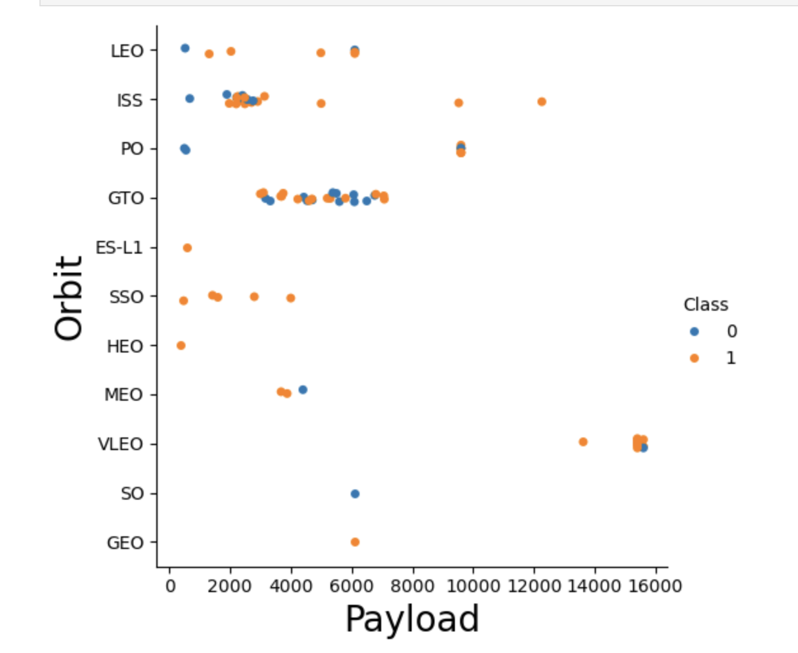
Payload vs. Orbit Type
We can observe that with heavy payloads, the successful landing are more for PO, LEO and ISS orbits.

Slide 25
Launch Success Yearly Trend
From the plot, we can observe that success rate since 2013 kept on increasing till 2020.

Slide 26
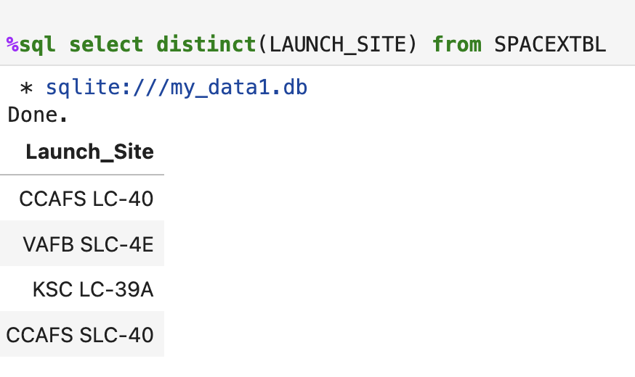
All Launch Site Names
We used the key word DISTINCT to show only unique launch sites from the SpaceX data.

Slide 27
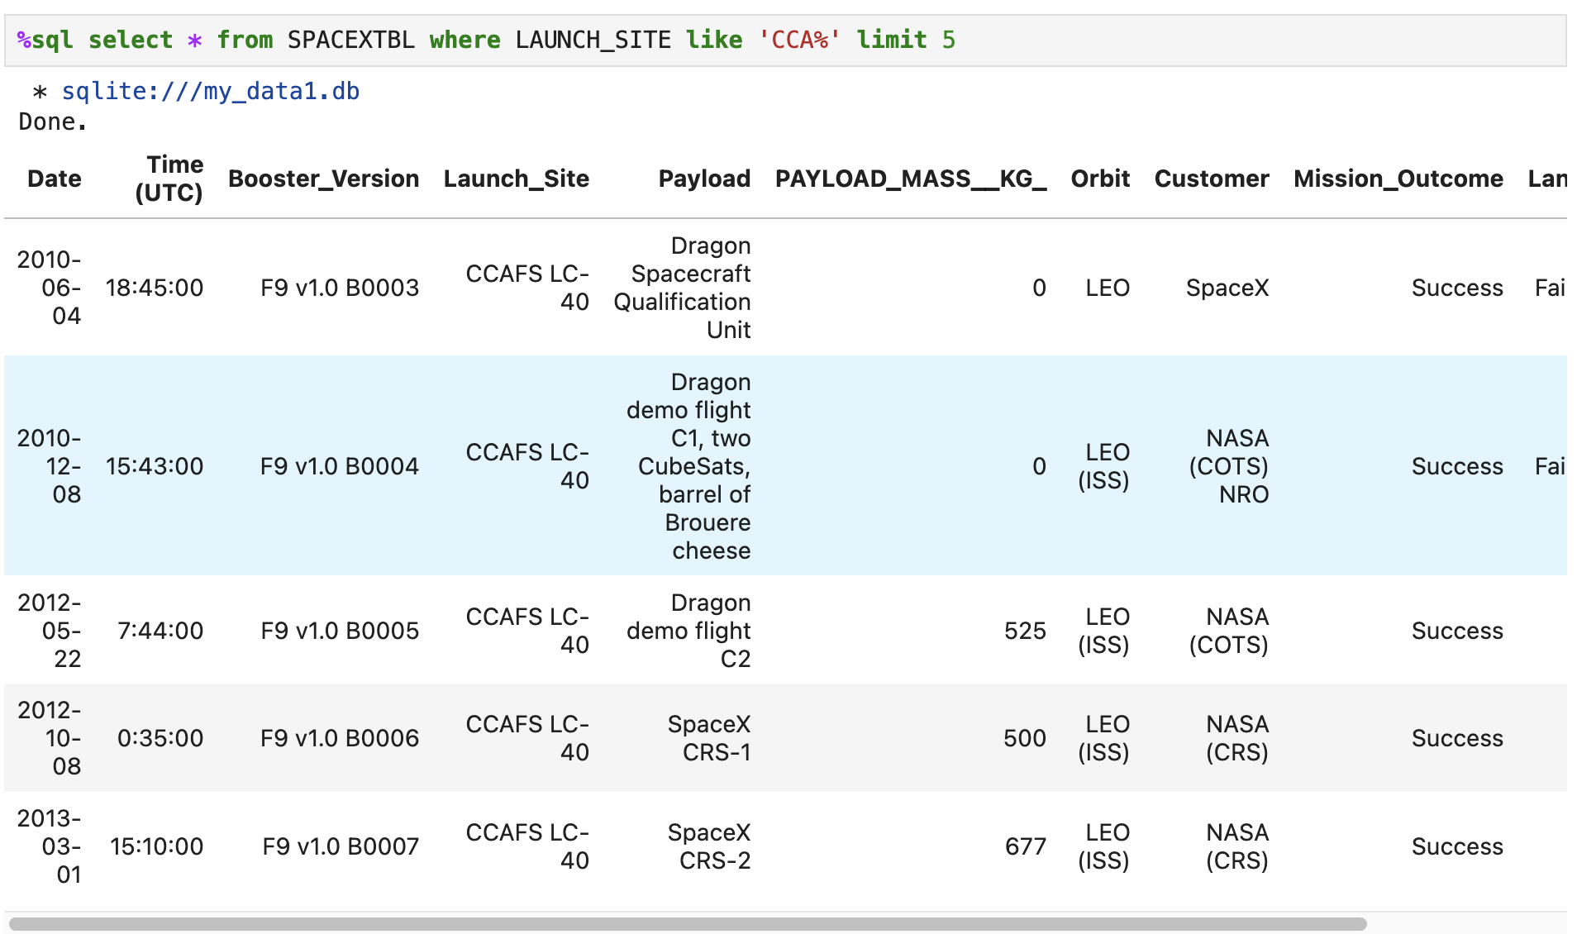
Launch Site Names Begin with 'CCA'
We used the query below to display 5 records where launch sites begin with `CCA`.

Slide 28
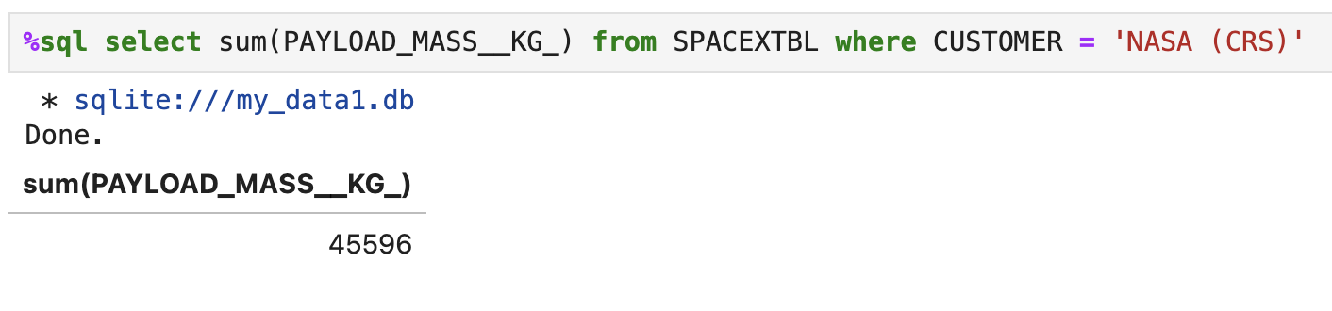
Total Payload Mass
We calculated the total payload carried by boosters from NASA as 45596 using the query below

Slide 29
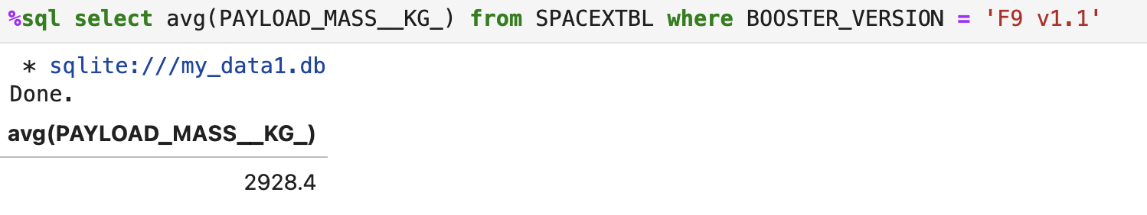
Average Payload Mass by F9 v1.1
We calculated the average payload mass carried by booster version F9 v1.1 as 2928.4

Slide 30
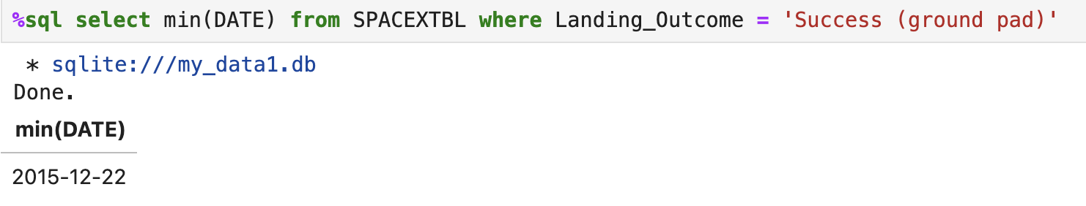
First Successful Ground Landing Date
We observed that the dates of the first successful landing outcome on ground pad was 22nd December 2015

Slide 31
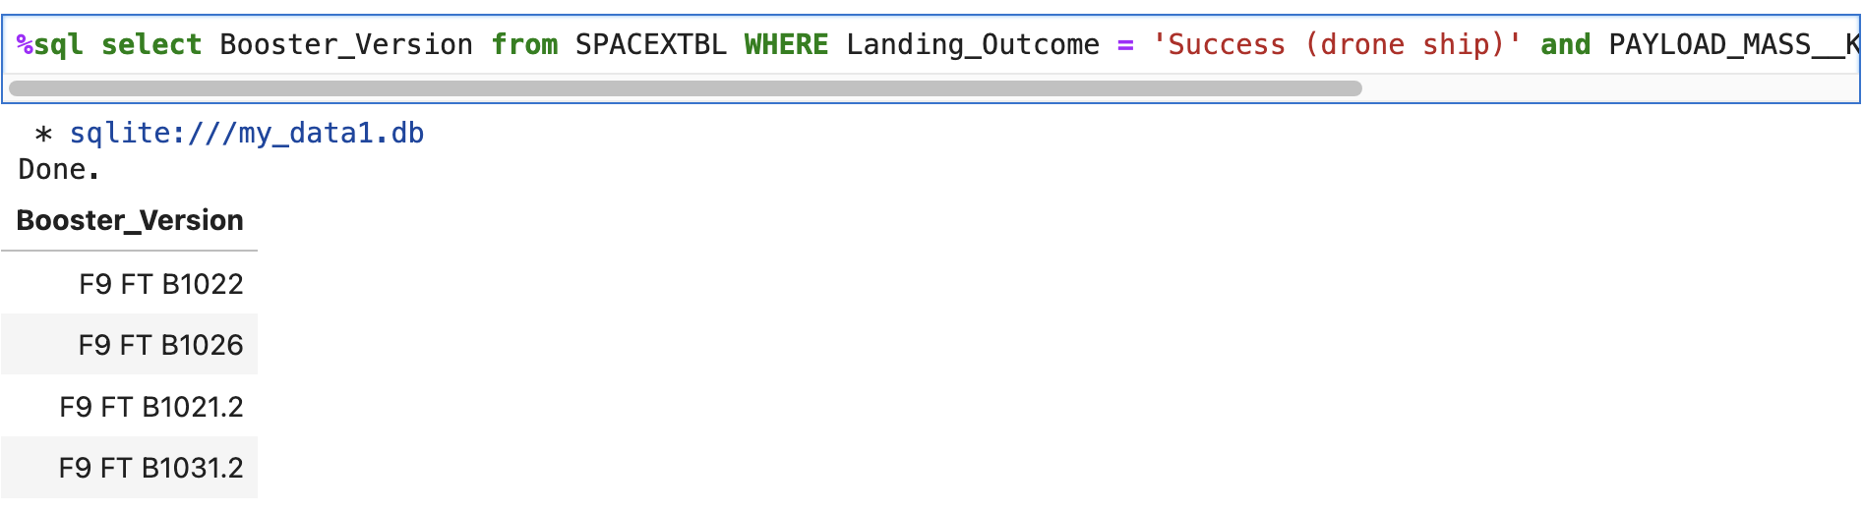
Successful Drone Ship Landing with Payload between 4000 and 6000
We used the WHERE clause to filter for boosters which have successfully landed on drone ship and applied the AND condition to determine successful landing with payload mass greater than 4000 but less than 6000

Slide 32
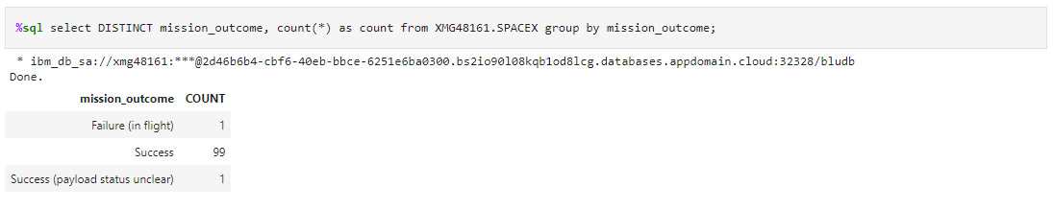
Total Number of Successful and Failure Mission Outcomes
We used wildcard like ‘%’ to filter for WHERE MissionOutcome was a success or a failure.

Slide 33
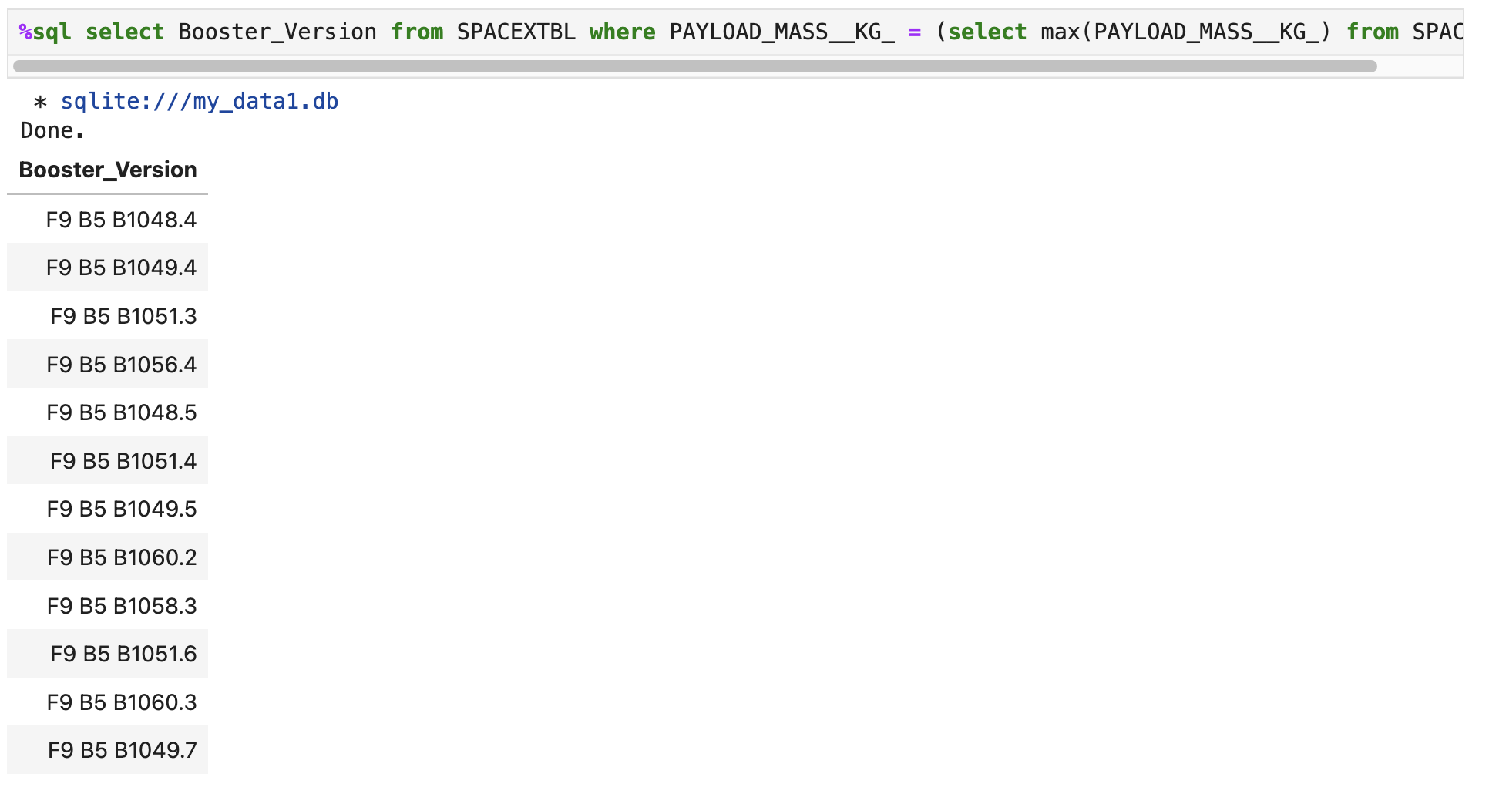
Boosters Carried Maximum Payload
We determined the booster that have carried the maximum payload using a subquery in the WHERE clause and the MAX() function.

Slide 34
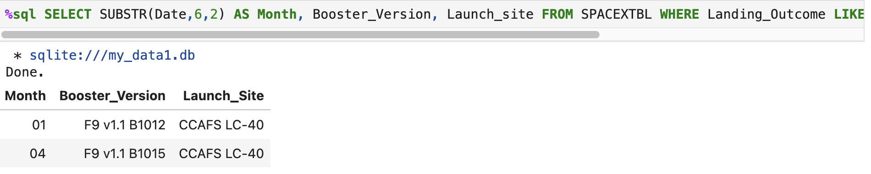
2015 Launch Records
We used a combinations of the WHERE clause, LIKE, AND, and BETWEEN conditions to filter for failed landing outcomes in drone ship, their booster versions, and launch site names for year 2015

Slide 35
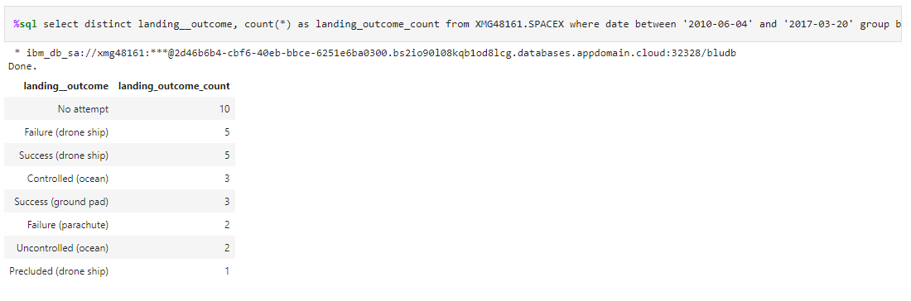
Rank Landing Outcomes Between 2010-06-04 and 2017-03-20
We selected Landing outcomes and the COUNT of landing outcomes from the data and used the WHERE clause to filter for landing outcomes BETWEEN 2010-06-04 to 2010-03-20.
We applied the GROUP BY clause to group the landing outcomes and the ORDER BY clause to order the grouped landing outcome in descending order.

Slide 36

Section 3

Slide 37
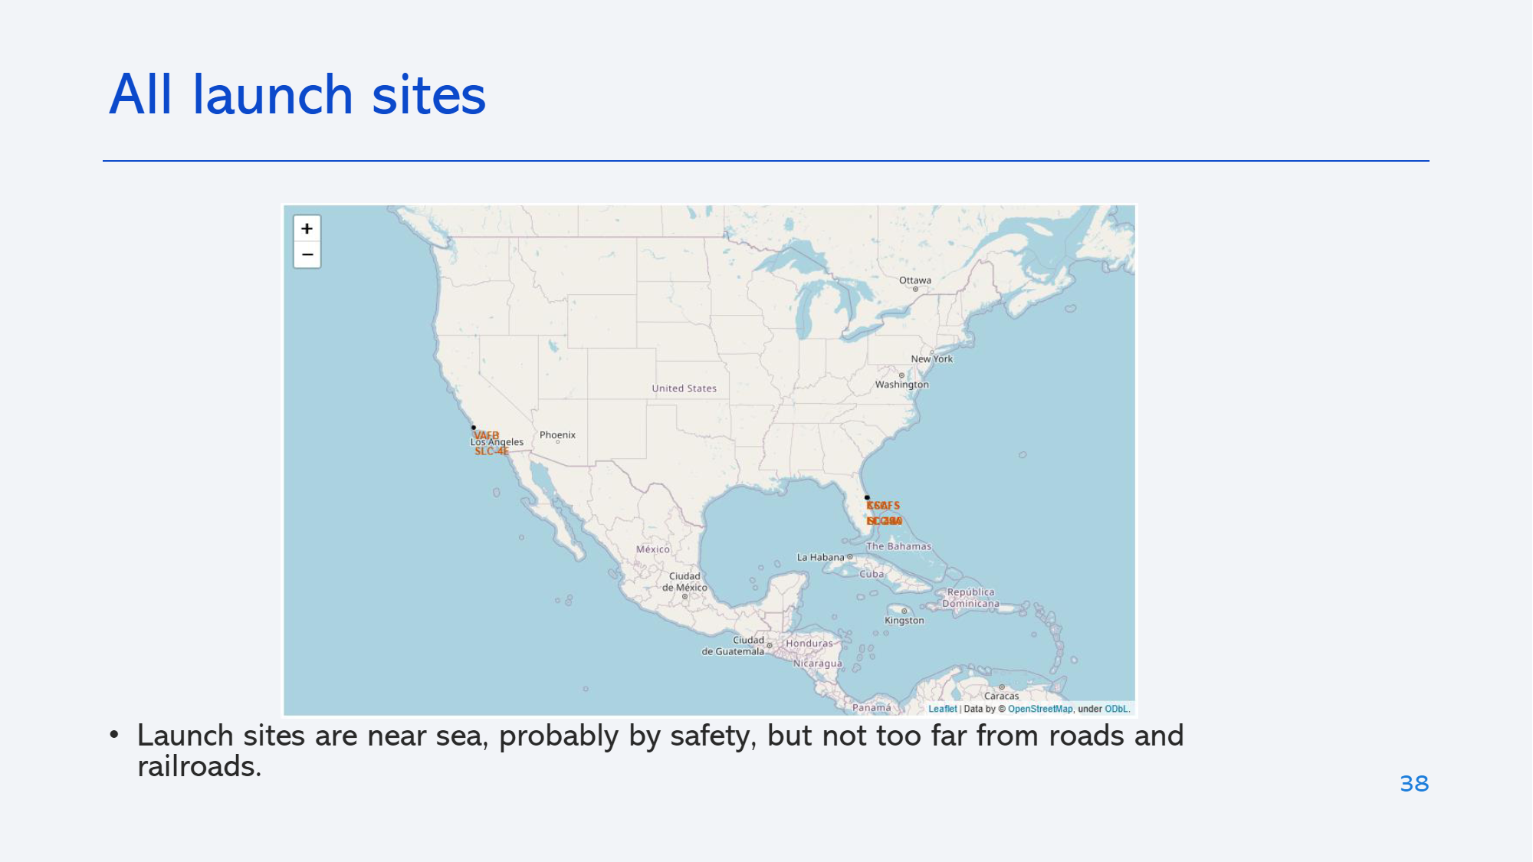
All Launch Sites
All the launch sites are near to the sea.
The launch should be taken with utmost safety as there is some areas of land nearby.

Slide 38
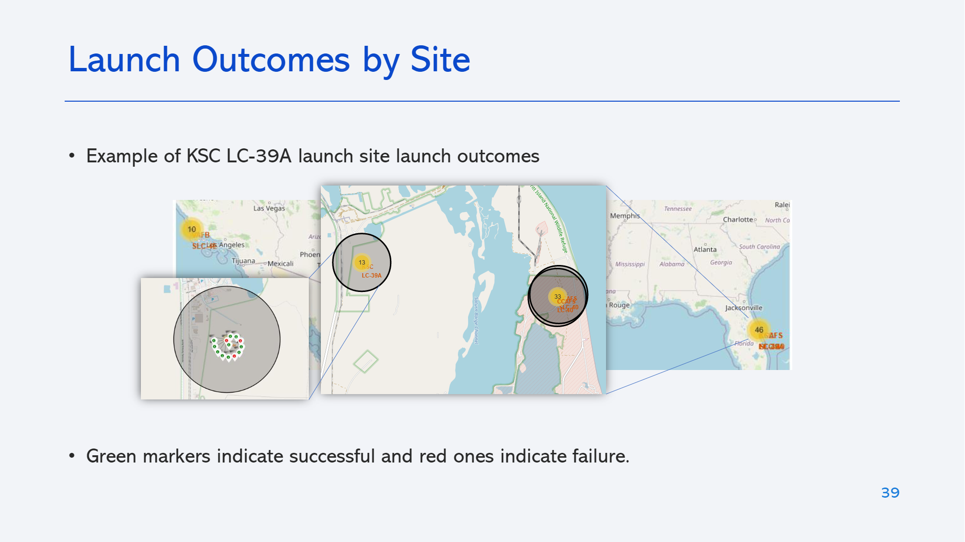
Launch Outcomes based on Sites
The green markers in the map gives out successful launch outcomes and red marker gives out failed launch outcomes

Slide 39
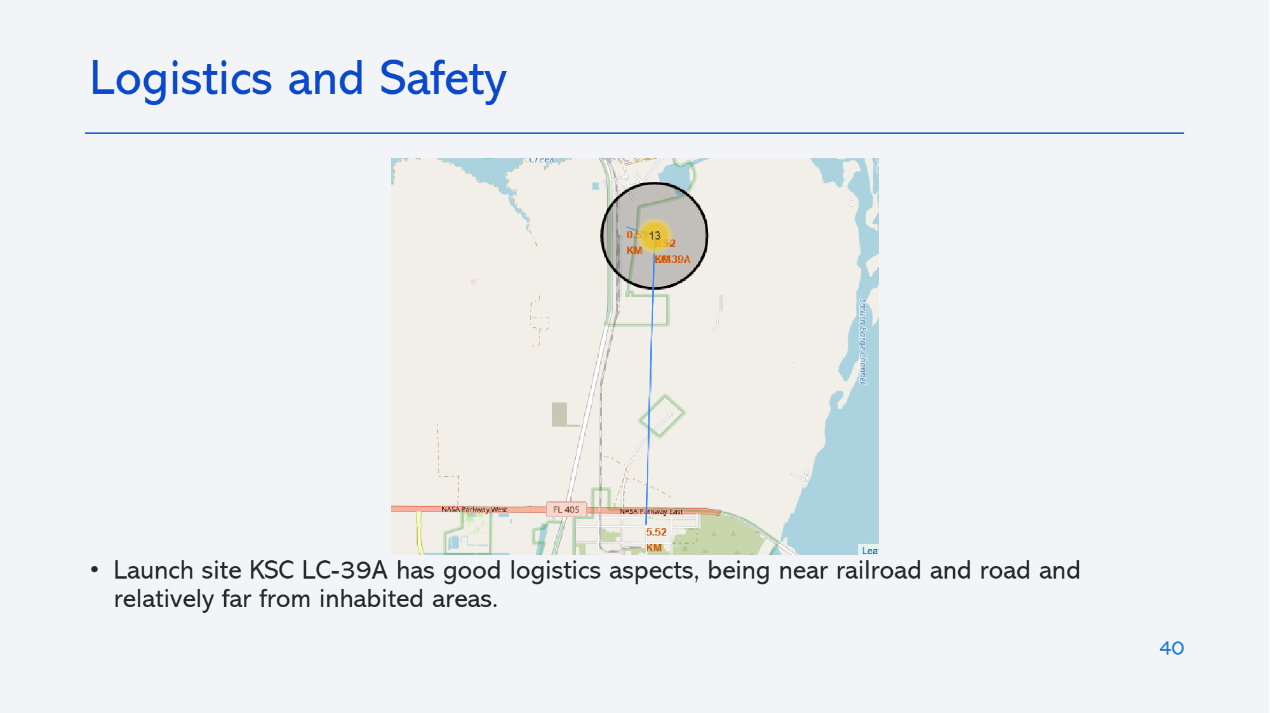
Launch Site distance to landmarks
A line is drawn between the launch site and its closest Highway.

Slide 40

Section 4

Slide 41
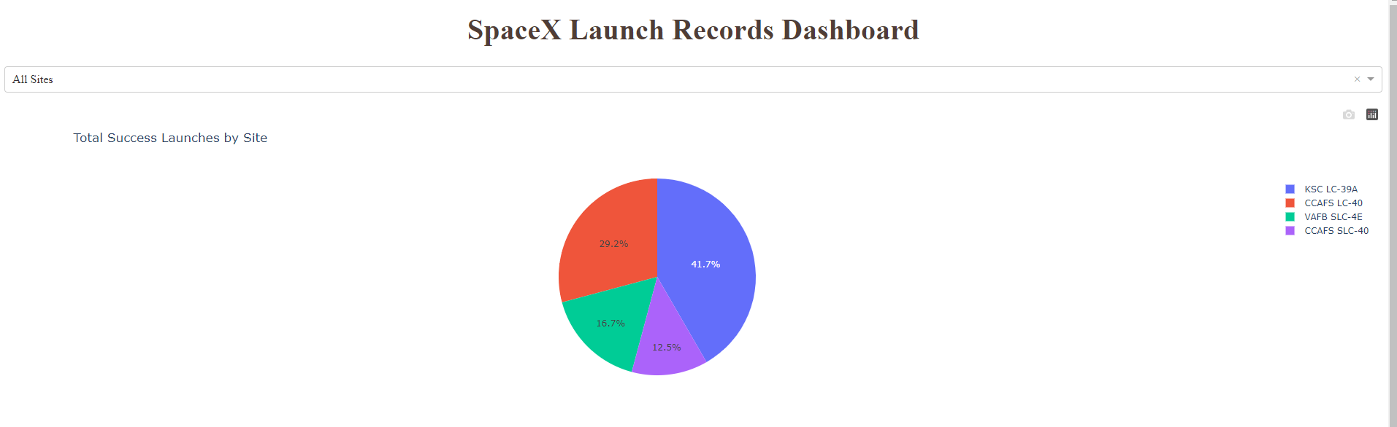
Pie chart showing the success percentage achieved by each launch site
Pie chart with the success rate of rocket launched based on sites.

Slide 42
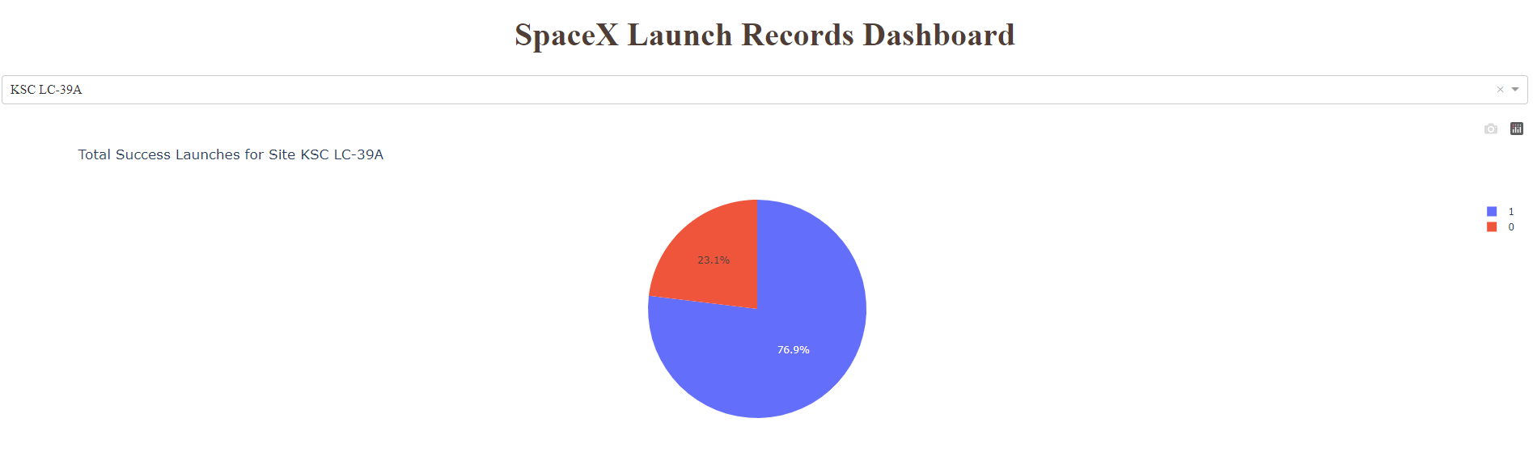
Pie chart showing the Launch site with the highest launch success ratio
The pie chart which has the highest successful launches based on Launch Site

Slide 43
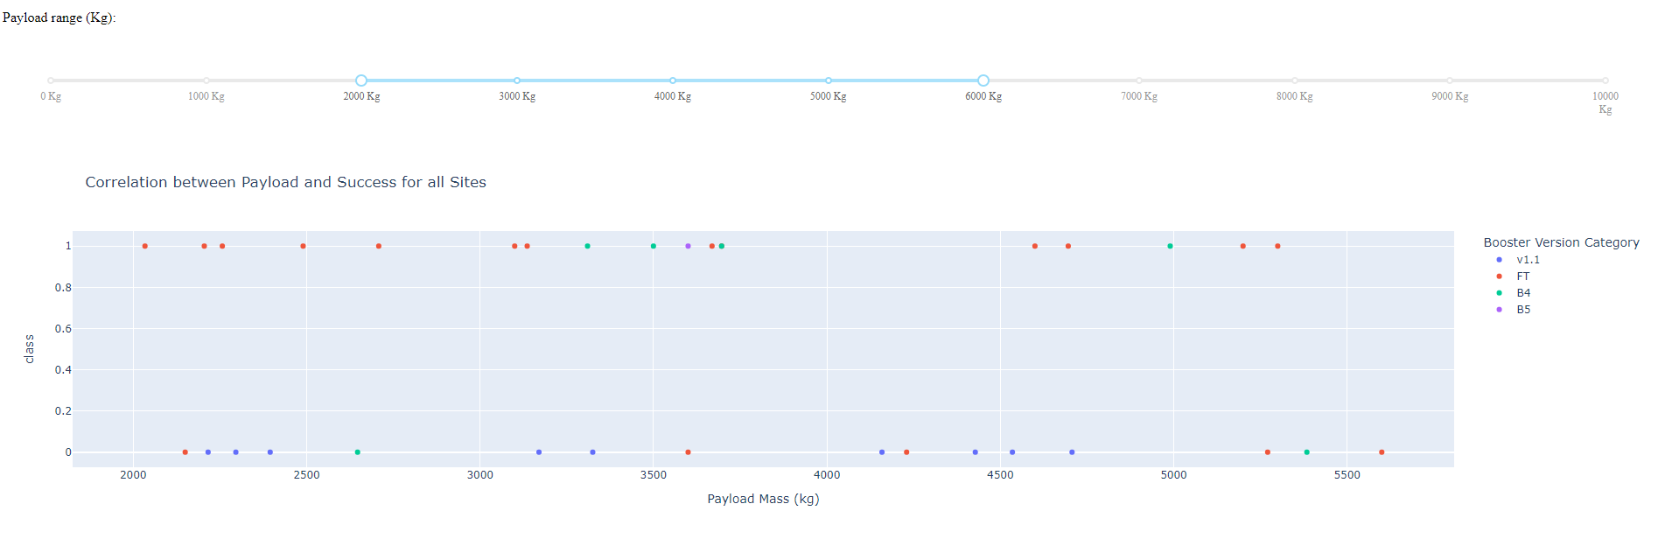
Scatter plot of Payload vs Launch Outcome for all sites, with different payload selected in the range slider
This Scatter Plot shows the success rate based on Payload Mass of rockets between 2000 and 6000 KG

Slide 44

Section 5

Slide 45
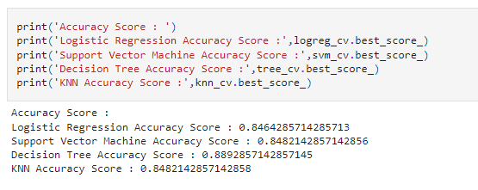
Classification Accuracy
Decision tree has highest accuracy.

Slide 46
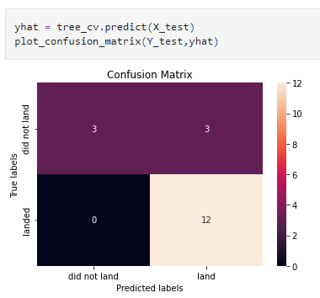
Confusion Matrix
The confusion matrix for the decision tree classifier shows that the classifier can distinguish between the different classes. The major problem is the false positives .i.e., unsuccessful landing marked as successful landing by the classifier.

Slide 47
Conclusions
We can conclude that
The larger the flight amount at a launch site, the greater the success rate at a launch site.
Launch success rate started to increase in 2013 till 2020.
Orbits ES-L1, GEO, HEO, SSO, VLEO had the most success rate.
KSC LC-39A had the most successful launches of any sites.
The Decision tree classifier is the best machine learning algorithm for this task.

Slide 48


